Slide 1

CSC- 362 Computer Networks Week-3 Lecture-5 &6
Prepared by:
Mr. Attique Ur Rehman

Slide 2
Instructor Contact Details
Name: Mr. Attique Ur Rehman
Course Instructor: CSC362- Computer Networks
Credit Hours: (3+1)=4
Office Location: 2nd Floor Computer Science Faculty Office: 41-C
Email: attique.rehman@lgu.edu.pk
Visiting Hours: Wednesday (11:30 am -1:00 pm)

Slide 3
Course Material
Reference books
Many textbooks on Networking may be consulted
Research papers!
RFCs and Internet drafts
Related to TCP/IP suite and other protocols
Web resources
Tutorials, white papers, reports, etc.

Slide 4
Text Book
Computer Networks: A Systems Approach by Larry L. Peterson and Bruce S. Davies.
Third Edition [2003], Morgan Kaufmann Publishers, San Mateo, California, USA
Computer Networks by Andrew S. Tanenbaum
Fifth Edition
Data Communication and Computer Networks, by Behrouz A. Forouzan
5th Edition
Data and Computer Communications by William Stallings
10th Edition
Computer Networking: A Top-Down Approach Featuring the Internet by James F. Kurose and Keith W. Ross
6th edition

Slide 5
Outline
Data Link Layer
Purpose of the DLL
Elementary Data Link Protocols
Framing

Slide 6
LAYER 2: Data Link Layer
Concerned with
Framing
Physical addressing
Network access / Access control
Error control
error notification,
error free (CRC)
Ordered delivery of frames
Flow control.

Slide 7
Purpose of the DLL
To transfer blocks of data without error between two adjacent devices
connected by a communication channel conceptually act like wire (telephone lines, coaxial cables, optical fibres, satellites, point to point wireless channel).
The implication of such a physical link (wire like channel) is that the data bits are delivered in exactly the same order in which they are sent.

Slide 8
Purpose of the DLL
The physical link has no inherent storage capacity, therefore the delay involved is the propagation delay over the link.
Transmission of data over the link would be very simple indeed if no error ever occurred
Unfortunately, this is not so in a real physical link
Natural phenomena such as noises and interference are introduced into the link causing errors in detecting the data.

Slide 9
Purpose of the DLL
There is a finite data processing time required by the transmitting and receiving stations.
A communication links have following limitations
makes errors occasionally
Have a finite data rate
There is nonzero propagation delay

Slide 10
Functions of DLL
The data link layer has three specific functions:
Provide a well-defined interface to the network layer.
Deal with transmission errors.
Regulate the flow of data (so that slow receivers are not overloaded).

Slide 11
The DLL (cont’d)‏
The Data Link Layer sits between the Network Layer and the Physical Layer.
The DLL provides an interface for the Network Layer to send information from one machine to another.
The function of DLL is to provide services to the network layer.

Slide 12
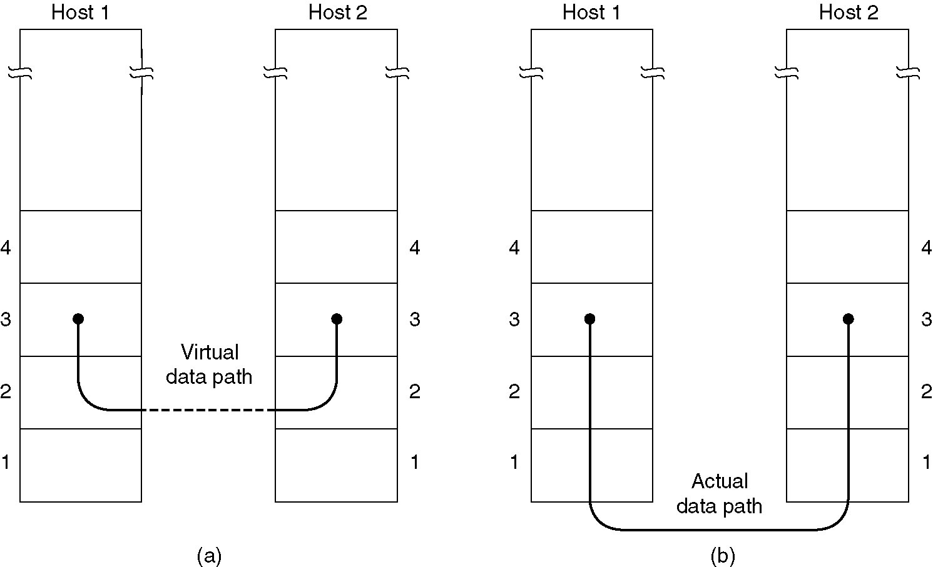
Data Flow

Slide 13
How data is moved.
The DLL is responsible for taking the packets of information that it receives from the Network Layer and putting them into frames for transmission.
Each frame holds the payload plus a header and a trailer (overhead).
It is the frames that are transmitted over the physical layer.

Slide 14
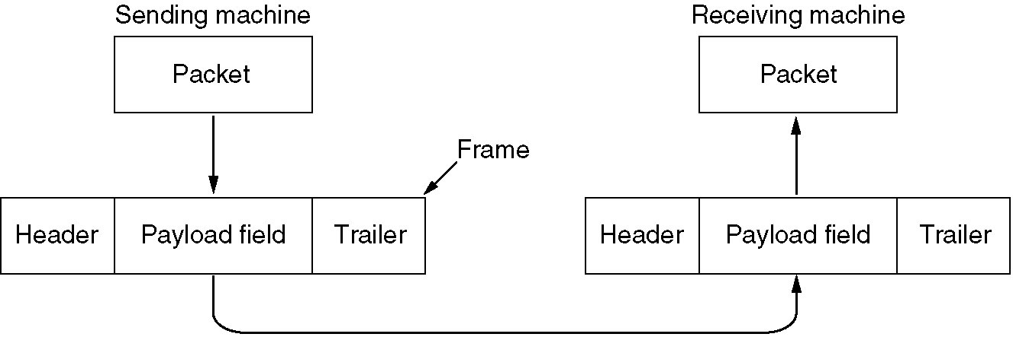
Packets and Frames

Slide 15
Why protocols required at DLL?

Slide 16
Requirements of the DLL Protocols
To ensure an error-free transmission
To achieve an efficiency of the data transfer as high as possible

Slide 17
Function of the DLL Protocols
The protocol (control mechanism) should be capable of performing:
The identification of a frame (i.e. recognize the first and last bits of a frame).
The transmission of frames of any length up to a given maximum. Any bit pattern is permitted in a frame.
The detection of transmission errors.
The retransmission of frames which were damaged by errors.
The assurance that no frames were lost.
In a multidrop configuration
Some mechanism must be used for preventing conflicts caused by
simultaneous transmission by many stations.
The detection of failure or abnormal situations for control and monitoring purposes.

Slide 18
DLL Services
The Data Link Layer can offer many different services.
These services can vary from system to system.
Common services:
Unacknowledged connectionless service.
Acknowledged connectionless service.
Acknowledged connection-oriented service.

Slide 19
Unacknowledged Connectionless Service
No acknowledgement from the receiving machine.
No logical connection is set up between the two machines.
The DLL will make no attempt to detect the loss of or recover a lost frame.
This service is useful for low error rate networks and for real-time traffic where late data is worse than no data.

Slide 20
Acknowledged Connectionless Service
The receiver acknowledges the arrival of each frame.
If it hasn’t arrived correctly (or within the correct time) it can be resent.
This is a useful service when the connection is unreliable (such as wireless)‏
There is no requirement for such an acknowledgement service to be implemented by the Data Link Layer.

Slide 21
Acknowledged Connection-Oriented Service
A connection is established between the two machines.
The frames are then transmitted and each frame is acknowledged.
The frames are guaranteed to arrive only once and in order.
This is the same as a “reliable” bit stream.
The connection is released once the communication is complete.

Slide 22
Extra DLL Features
The DLL does not have to implement the acknowledged connectionless service – the error handling can be managed at the network layer.
It is an optimization at the DLL because it requires only retransmitting a frame only – not a whole message.
This speeds up the sending of larger messages on poor networks.

Slide 23
Framing
Breaks continuous stream/sequence of bits into a frame and demarcates units of transfer
Typically implemented by network adaptor
Adaptor fetches/deposits frames out of/into host memory
Node A
Adaptor
Bits
Adaptor
Node B
Frames

Slide 24
Advantages of Framing
Synchronization recovery
consider continuous stream of unframed bytes
Multiplexing of link
multiple hosts on shared medium
simplifies multiplexing of logical channels
Efficient error detection
frame serves as unit of detection (valid or invalid)‏
error detection overhead scales as log N

Slide 25
Problem … ?
Recognizing exactly the boundaries of a frame
Must determine the first and last bit of a frame

Slide 26
How are Frames sent?
The Physical Layer is only able to put a raw bit stream on the transmission media.
DLL needs to pack bits into frames, so that each frame can be distinguishable from another.
Putting spaces between the frames won’t work as we can’t guarantee that the spaces will stay.
Need to look at other methods of denoting the start and finish of a frame.

Slide 27
Framing Methods
Character count.
Flag bytes with byte stuffing
Starting and ending flags, with bit stuffing
Physical layer coding violations

Slide 28
Character Count
Uses a field in the header to specify the number of characters in the frame.
This method can cause problems if the count is garbled in transit.
The receiver will be able to tell the frame is bad (due to a bad checksum)‏
The receiver will not know where to pick up and the sender will not know how much to resend.
This method is rarely used anymore.

Slide 29
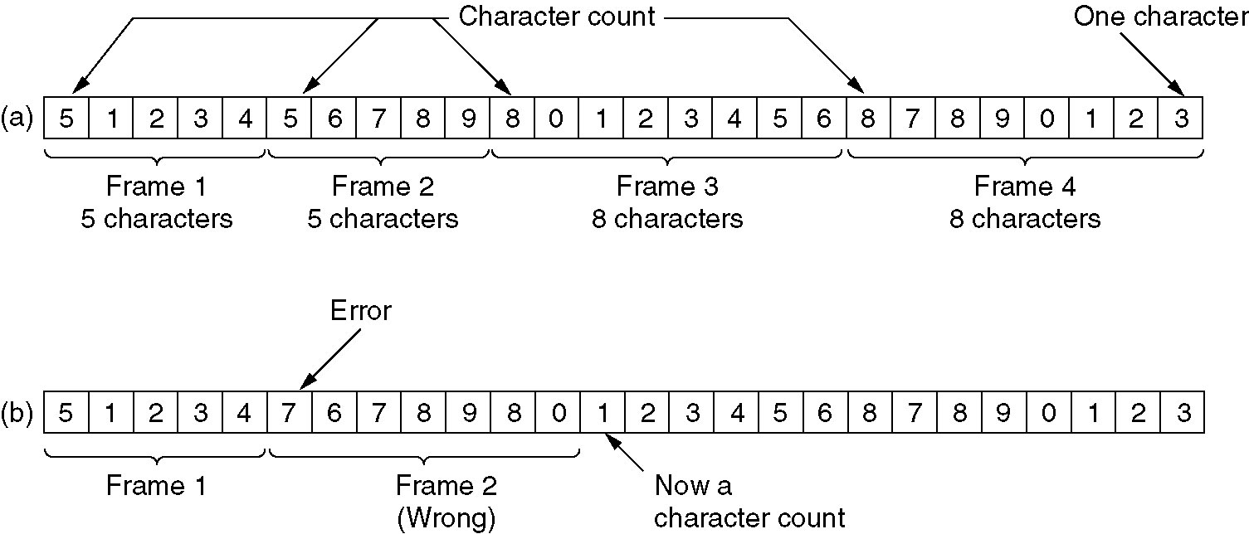
Character Count Example

Slide 30
Character Count
e.g., DDCMP (byte-oriented, variable-length)‏
e.g. RS-232 (bit-oriented, implicit fixed length)‏
Problem: count field corrupted
Solution: catch when CRC fails
Include payload length in header
8
8
8
14
42
16
SYN
SYN
Class
Length
Header
CRC
Body

Slide 31
Flag Bytes
Frames begin and end with special bytes.
Often used are the same start/end flag.
If the receiver gets “lost” synchronization, it just looks for a pair of flag bytes to denote the end of one frame and the start of the next.

Slide 32
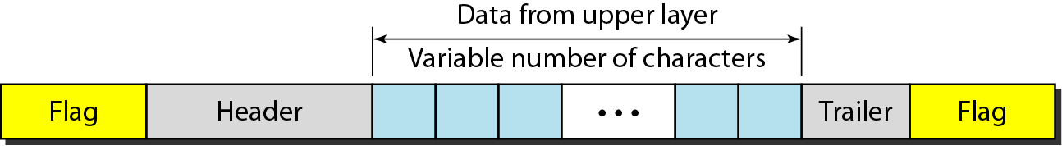
Flag Bytes
End of frame: special byte or bit pattern
Choice of end of frame marker
valid data byte or bit sequence e.g. 01111110
physical signal not used by valid data symbol
8
16
16
8
Beginning sequence
Header
CRC
Ending sequence
Body

Slide 33
We use Byte Stuffing!
Problem: What happens if the “flag” byte is accidentally transmitted in the message?
Solution: “Byte stuffing”
“Byte stuffing” is the process of putting an “ESC”ape character in front of any accidentally occurring FLAG in a message.
This is sometimes referred to as character stuffing.
What happens if an ESC accidentally occurs in a message? We ESC that too!

Slide 34
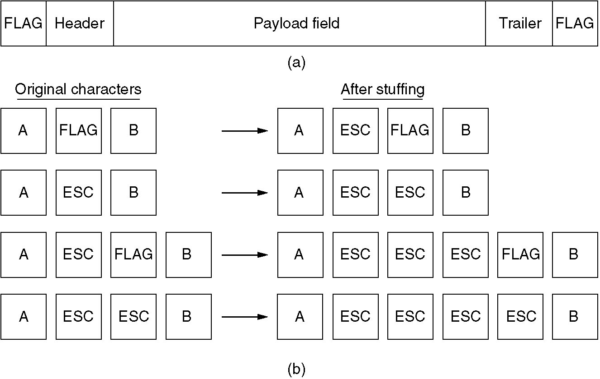
Example of Byte Stuffing
Byte stuffing is the process of adding 1 extra byte whenever there is a flag or escape character in the text.

Slide 35
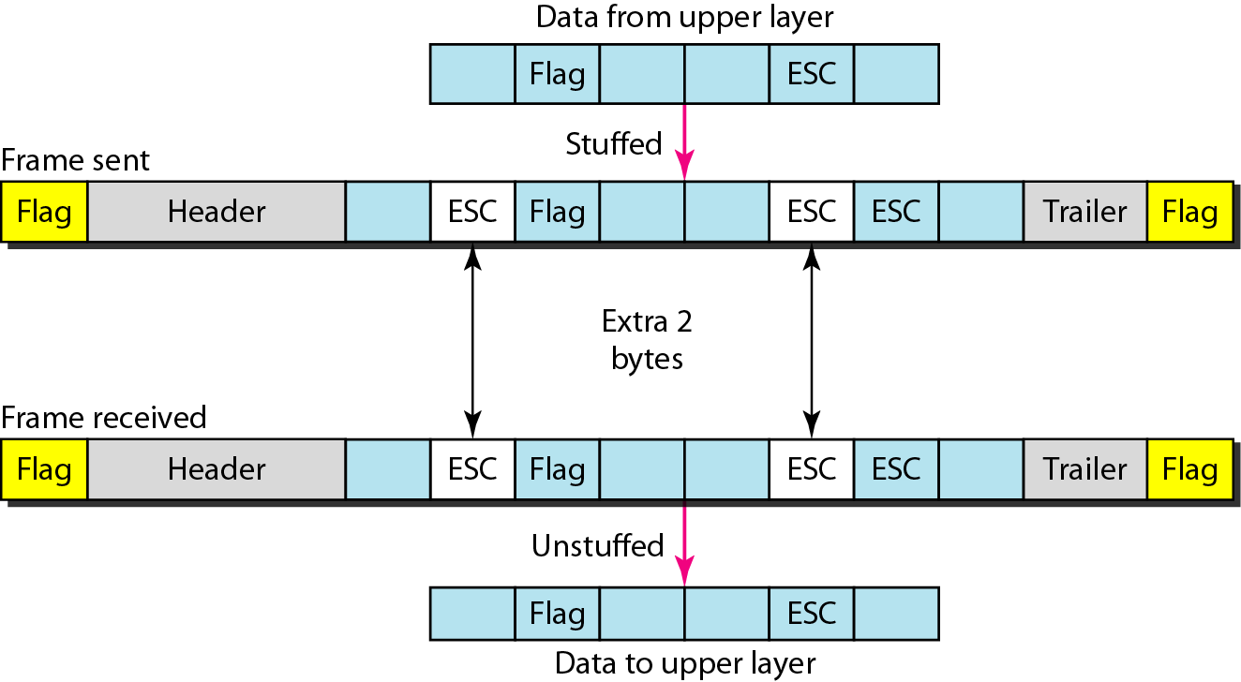
Example of Byte Stuffing and Unstuffing

Slide 36
Bit Stuffing
Problem: If two machines communicating where one uses 8-bit characters and one uses 16-bit characters than ?
Solution: We stuff bits instead of bytes.
sender: insert 0 after five consecutive 1s
receiver: delete 0 that follows five consecutive 1s
x
1
1
1
1
1
0
x
1
1
1
1
1
0
Node A
Node B
x
0
1
1
1
1
1
0
x
0
1
1
1
1
1
0

Slide 37
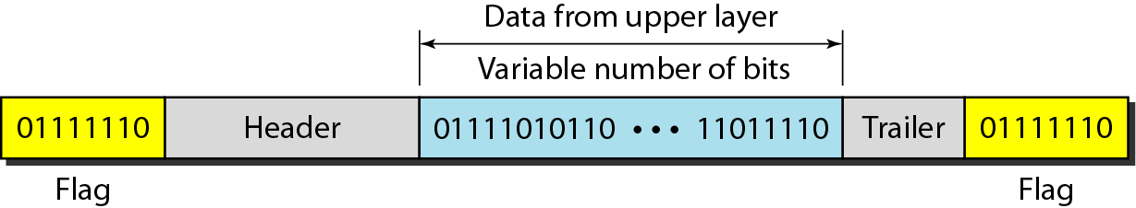
Bit Stuffing
Bit stuffing is the process of adding one extra 0 whenever five consecutive 1s follow a 0 in the data, so that the receiver does not mistake
the pattern 0111110 for a flag.

Slide 38
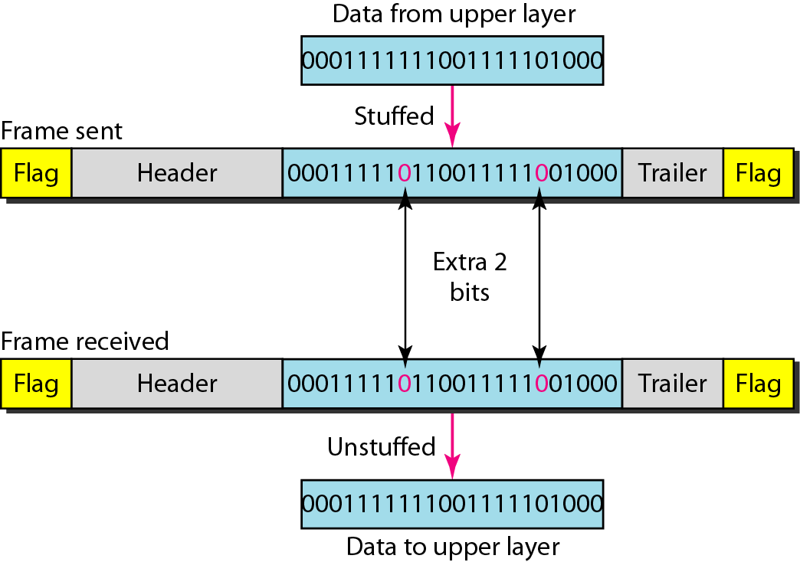
Example of Bit Stuffing and Unstuffing

Slide 39
Physical layer coding violations
Most DLL protocols use a combination of character count with another method for extra safety. This increases the chances of catching an error.

